Slide 1
Parallel & Distributed Computing
Chapter 1(Introduction)
Instructor: Yusra Mansoor
Email: yusra_mansoor@outlook.com

Slide 2
Course Description
The course introduces the main principles underlying distributed systems: processes, communication, naming, synchronization, consistency, fault tolerance, and security.
Students will be familiar with some of the main paradigms in distributed systems: object-based systems, file systems, web-based and coordination-based systems.
On the completion of the unit, students will understand the fundamentals of distributed computing and be able to design and develop distributed systems and applications.

Slide 3
Why Distributed Systems?
Many systems that we use on a daily basis are distributed
World wide web, Google
Amazon.com
Peer-to-peer file sharing systems
Useful to understand how such real-world systems work
Course covers basic principles for designing distributed systems

Slide 4
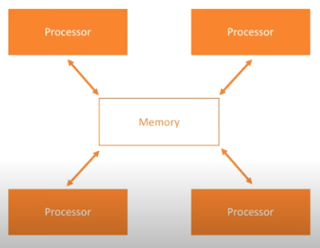
Parallel Computing
A system is said to be a parallel system in which multiple processor have direct access to shared memory which forms a common address space

Slide 5
Parallel Computing Advantages
Provide concurrency
Cost and time saving
Provides user-friendly programming
Taking advantage of non local resources

Slide 6
Distributed System
A distributed system is:
a system composed of several systems that require explicit communication among the components having a common goal set
A distributed system is a piece of software that ensures:
a collection of independent computers that appears to its users as a single coherent system.

Slide 7
Requirements
This requires:
A way for processes on different machines to exchange information (Process and Communication).
A way for process to access other entities (Naming).
A way for processes to cooperate, synchronize with one another and agree on shared values (Synchronization).
A way to enhance reliability and improve performance (Consistency and Replication).
A way to recover from partial failures (Fault Tolerance).

Slide 8
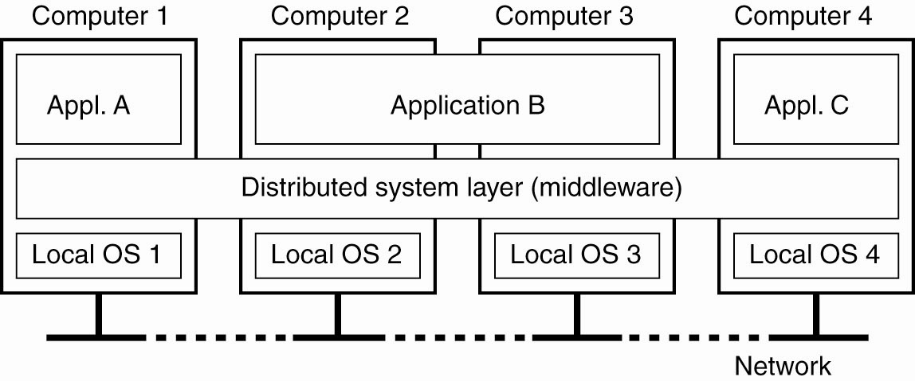
Distributed System

Slide 9
Goals of Distributed System
Making resources available
Problems of sharing? → security
Distribution transparency
To hide the fact that its processes and resources are physically distributed across multiple computers
Openness
To offer services according to standard rules that describe the syntax and semantics of those services
Scalability

Slide 10
Making Resources Available
Network Sharing
Remote Access
Resources:
Printers, Computers, Storage Facilities, Data, Files, Web Pages, etc.

Slide 11
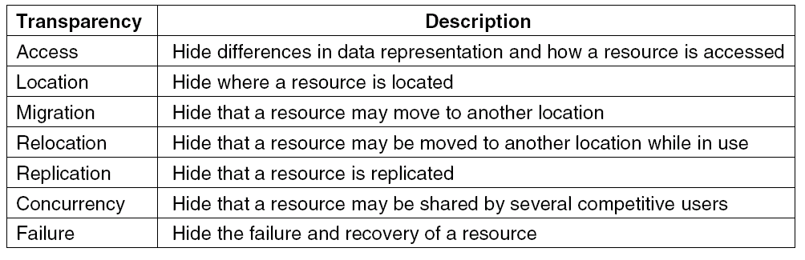
Distributed Transparency
Different forms of transparency in a distributed system (ISO, 1995).
Note: Distribution transparency is a nice goal, but achieving it is a different story.

Slide 12
Degree of Transparency
Aiming at full distributed transparency may be too much:
Users may be located in different continents
Completely hiding failures of networks and nodes is (theoretically and practically) impossible
You cannot distinguish a slow computer from a failing one
You can never be sure that a server actually performed an operation before a crash
Full transparency will cost performance, exposing distribution of the system
Keeping web caches exactly up-to-date with the master
Immediately flushing write operations to disk for fault tolerance

Slide 13
Openness
Open distributed system:
Be able to interact with services from other open systems, irrespective of the underlying environment:
Systems should conform to well-defined interfaces
Systems should support portability of applications
Systems should easily interoperate
Systems should easily extensible
Achieving openness:
At least make the distributed system independent from heterogeneity of the underlying environment:
Hardware
Platforms
languages

Slide 14
Scalability
A distributed system is scalable if it will remain effective when the number of resources and users is significantly increased
At least three aspects
Number of users and/or processes (size scalability)
Maximum distance between nodes (geographical scalability)
Number of administrative domains (administrative scalability)
Most systems account only, to a certain extent, for size scalability by using powerful servers.
Today, the challenge lies in geographical and administrative scalability.

Slide 15
Scalability Techniques
Distribution: Partition data and computations across multiple machines:
Move computations to clients (Java applets)
Decentralized naming services (DNS)
Replication: Make copies of data available at different machines:
Replicated file servers (mainly for fault tolerance)
Replicated databases
Mirrored Web sites
Caching: Allow client processes to access local copies:
Web caches (browser/Web proxy)
File caching (at server and client)

Slide 16
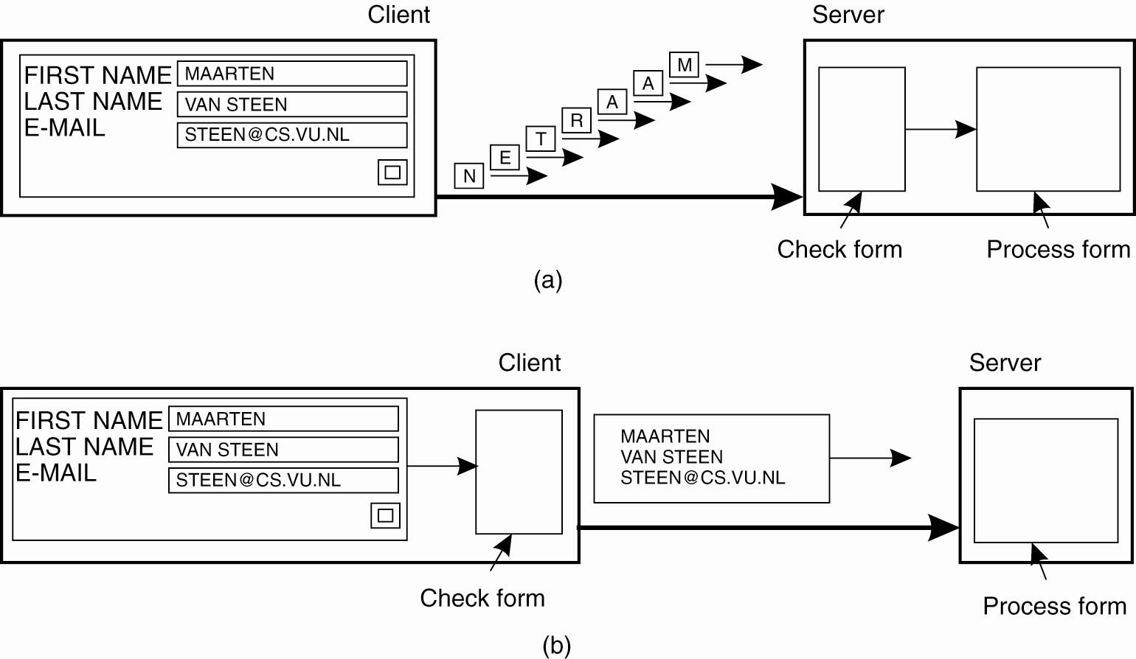
Scalability Techniques

Slide 17
Scalability Problem
Having multiple copies (cached or replicated), leads to inconsistencies
modifying one copy makes that copy different from the rest.
keeping copies consistent and in a general way requires global synchronization on each modification.
Global synchronization makes large-scale solutions practically impossible.
If we can tolerate inconsistencies, we may reduce the need for global synchronization.

Slide 18
Pitfalls When Developing Distributed Systems
False assumptions made by first time developer:
The network is reliable.
The network is secure.
The network is homogeneous.
The topology does not change.
Latency is zero.
Bandwidth is infinite.
Transport cost is zero.
There is one administrator.

Slide 19
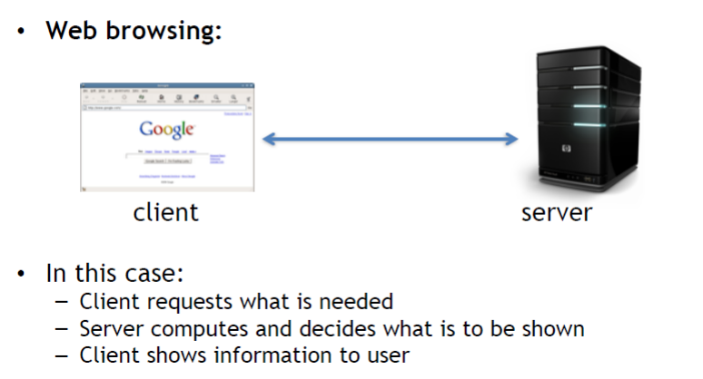
Examples

Slide 20
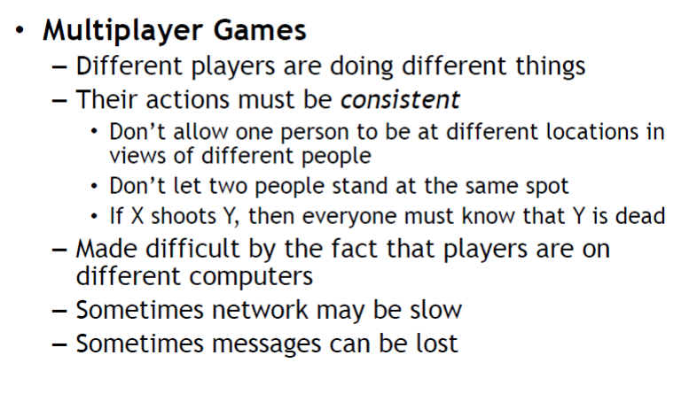
Examples

Slide 21
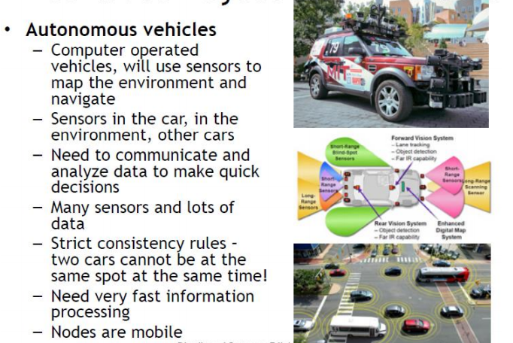
Examples

Slide 22
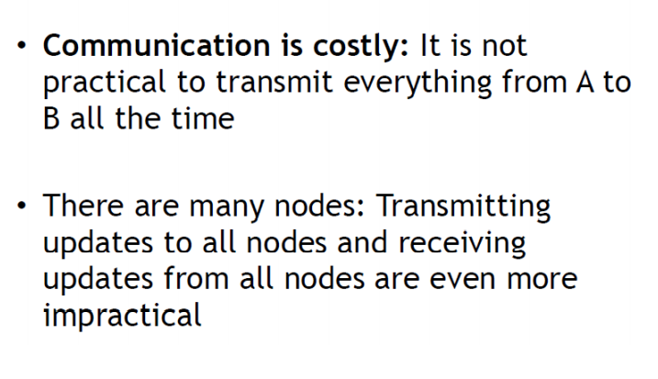
Challenges

Slide 23
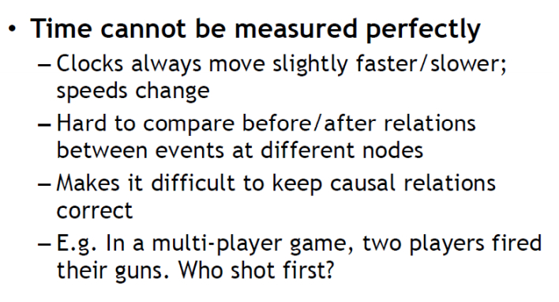
Challenges

Slide 24
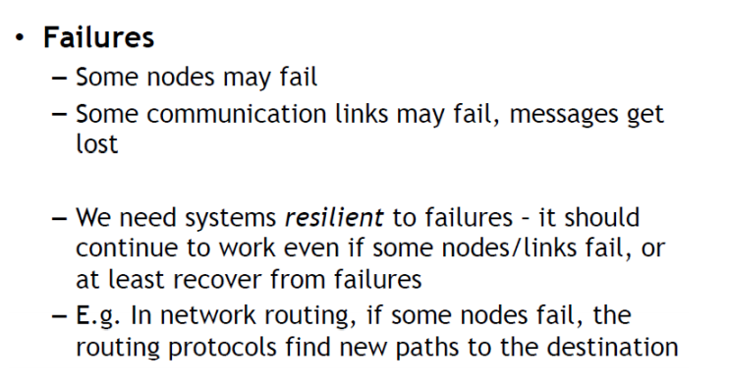
Challenges

Slide 25
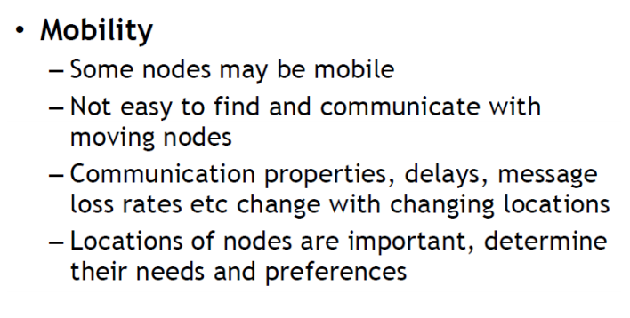
Challenges

Slide 26
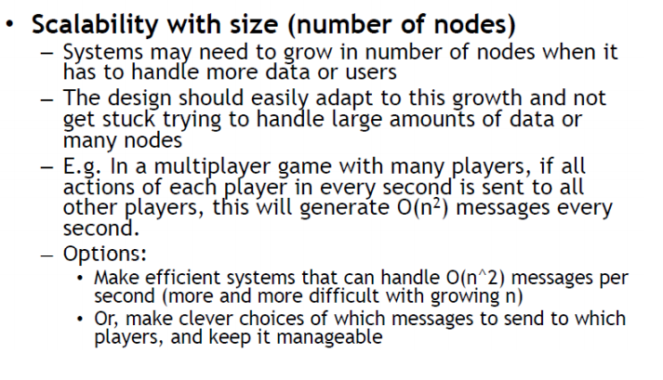
Challenges

Slide 27
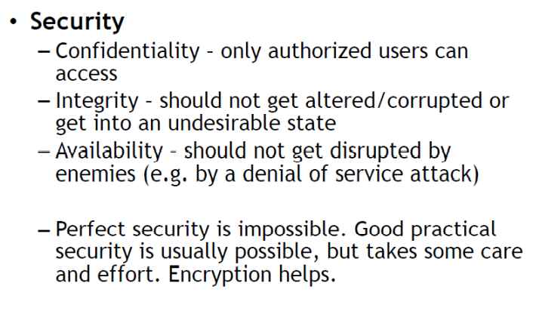
Challenges

Slide 28
Challenges

